Slide 1




Science Project 8: PaNOSC – Dynamics of biological processes using Small Angle Scattering
Miguel A. González, Irina Safiulina
Institut Laue-Langevin, Grenoble (France)

Slide 2
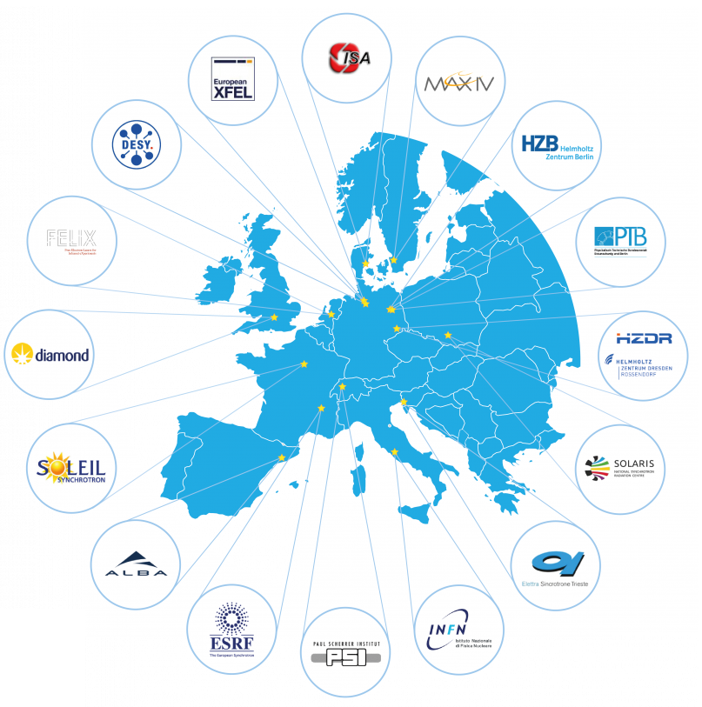
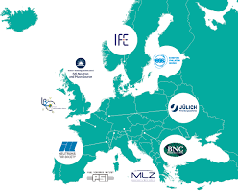
PaNOSC: What is it?
- Photon and Neutron Open Science Cloud (Grant no. 823852 in EU Horizon 2020 program)
- ExPaNDS (Grant no. 857641, PaNOSC complement for national facilities)
- Neutron (LENS) and synchrotron (LEAPS) facilities in Europe

Slide 3
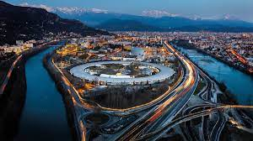
PaNOSC: What is it?
Neutron science in Europe:
Photon science in Europe:
35000 researchers
Since 1960s
19 facilities
>300 end-stations
>1 million hours beam time/year
5000+ publications/year
5 Nobel prizes

Slide 4
PaNOSC: The challenge of diversity
Very diverse scientific communities
1000s of individual experiments
Data and metadata?
FAIR data
Instrument metadata
Experiment metadata
Sample metadata
Other characterization
✓
✓
✓
❔
❔
✖
✖

Slide 5
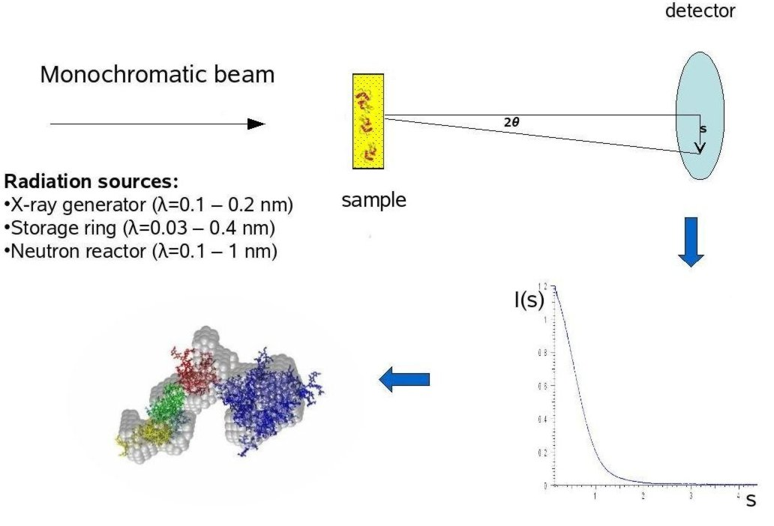
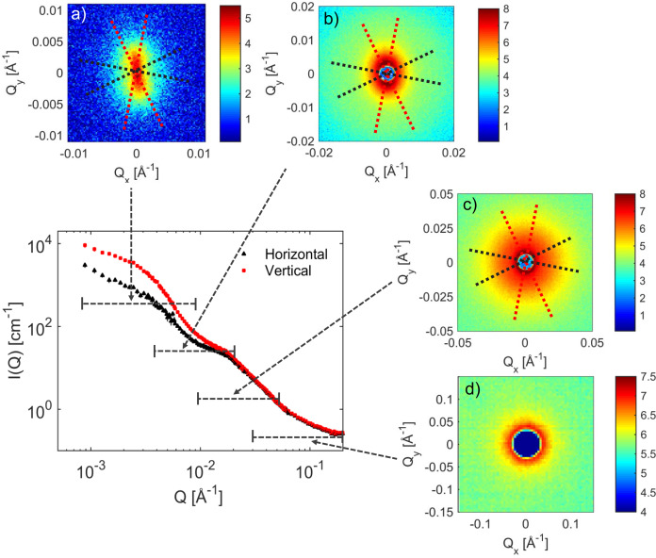
EOSC Future: Scientific project
Focus in a single technique: Small Angle (Neutron/X-ray) Scattering (SANS/SAXS)
and a single problem: Conformation of proteins and macromolecular complexes.
Tian et al, Food hydrocolloids (2020)

Slide 6
EOSC Future: Scientific project
Create simple workflow allowing non-expert users to examine with SANS/SAXS data of biological samples, collected at neutron and synchrotron facilities.
Action | Steps to be covered | Comments | Final solution
Full workflow | Data reduction | Too broad variety of instruments and data reduction algorithms even within one facility | ❌
 | Modelling | Open source software: IMP, Inria | ✅
 | Data analysis | Open source software: IMP, Inria | ✅
Access to the data | RSCB data bank | Input: https://www.rcsb.org | ✅
 | SASBDB data base | Input: https://www.sasbdb.org | ✅
 | Original data | Input from the user | ✅
Access to the workflow | VISA | Individual access for each facility | ✅
 | EGI Notebook | Requires UmbrellaID | ✅

Slide 7
EOSC Future: Scientific project
Open databases
training
Jupyter Notebook with all prerequisites installed*
Data
re-analysis
Publishing
Original data
own analysis
* IMP library (foxs, rrt_sample, multi_foxs)
Inria (NOLB, Pepsi-SAXS, Pepsi-SANS)
Python packages (nglview, pytraj, pandas, matplotlib)

Slide 8
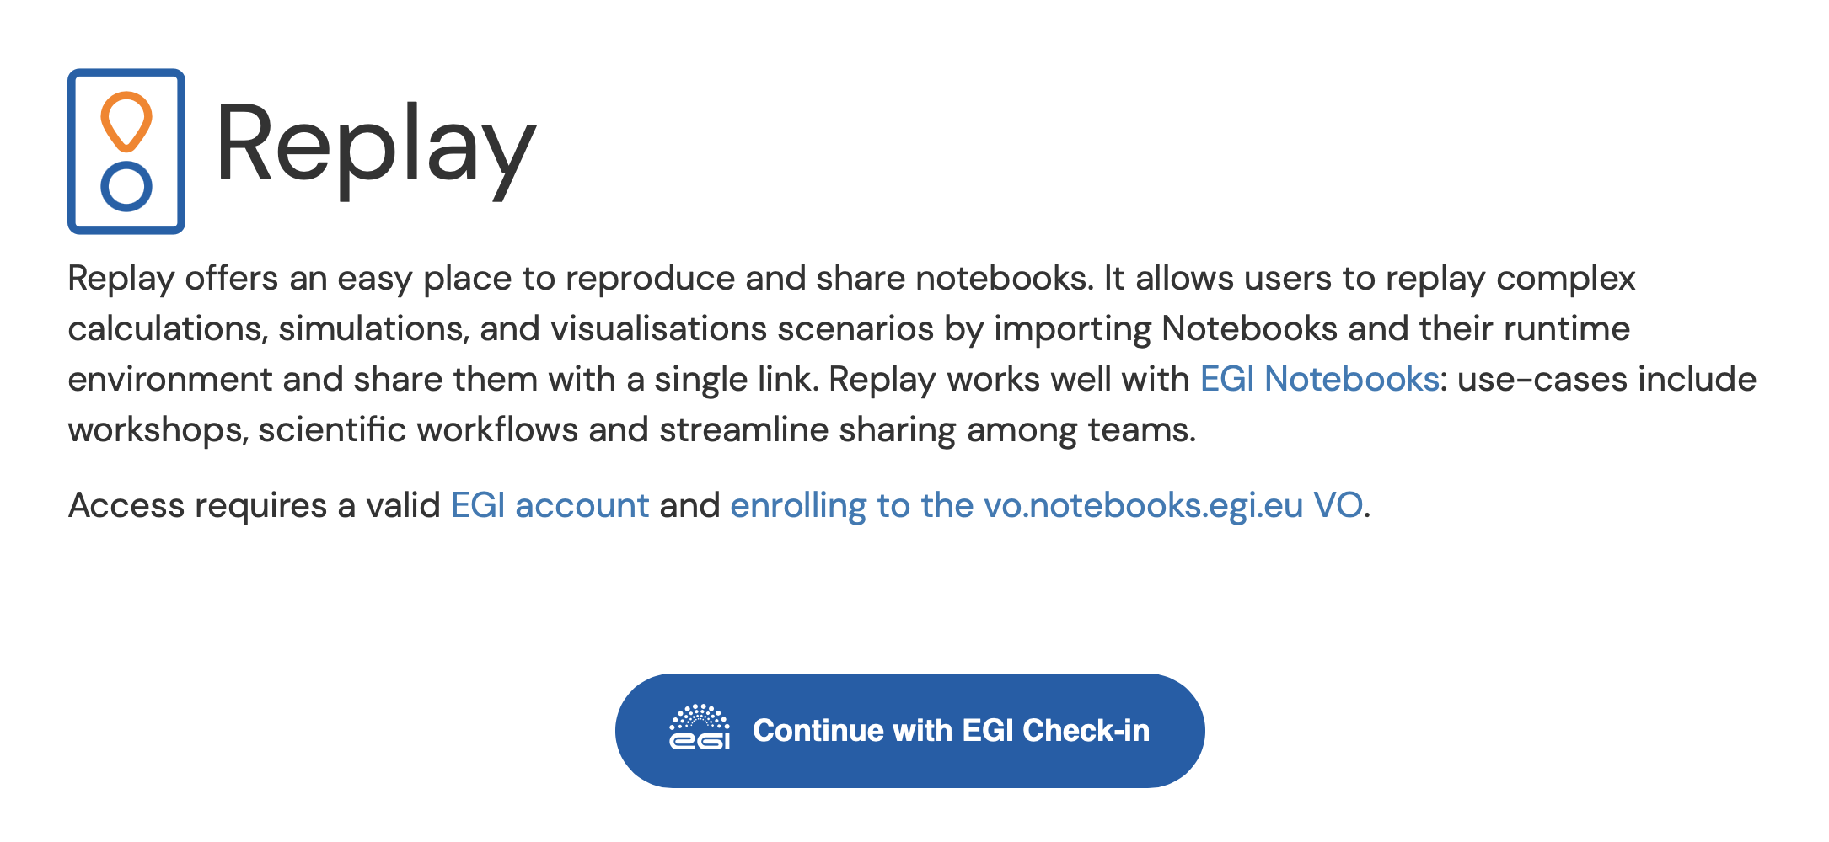
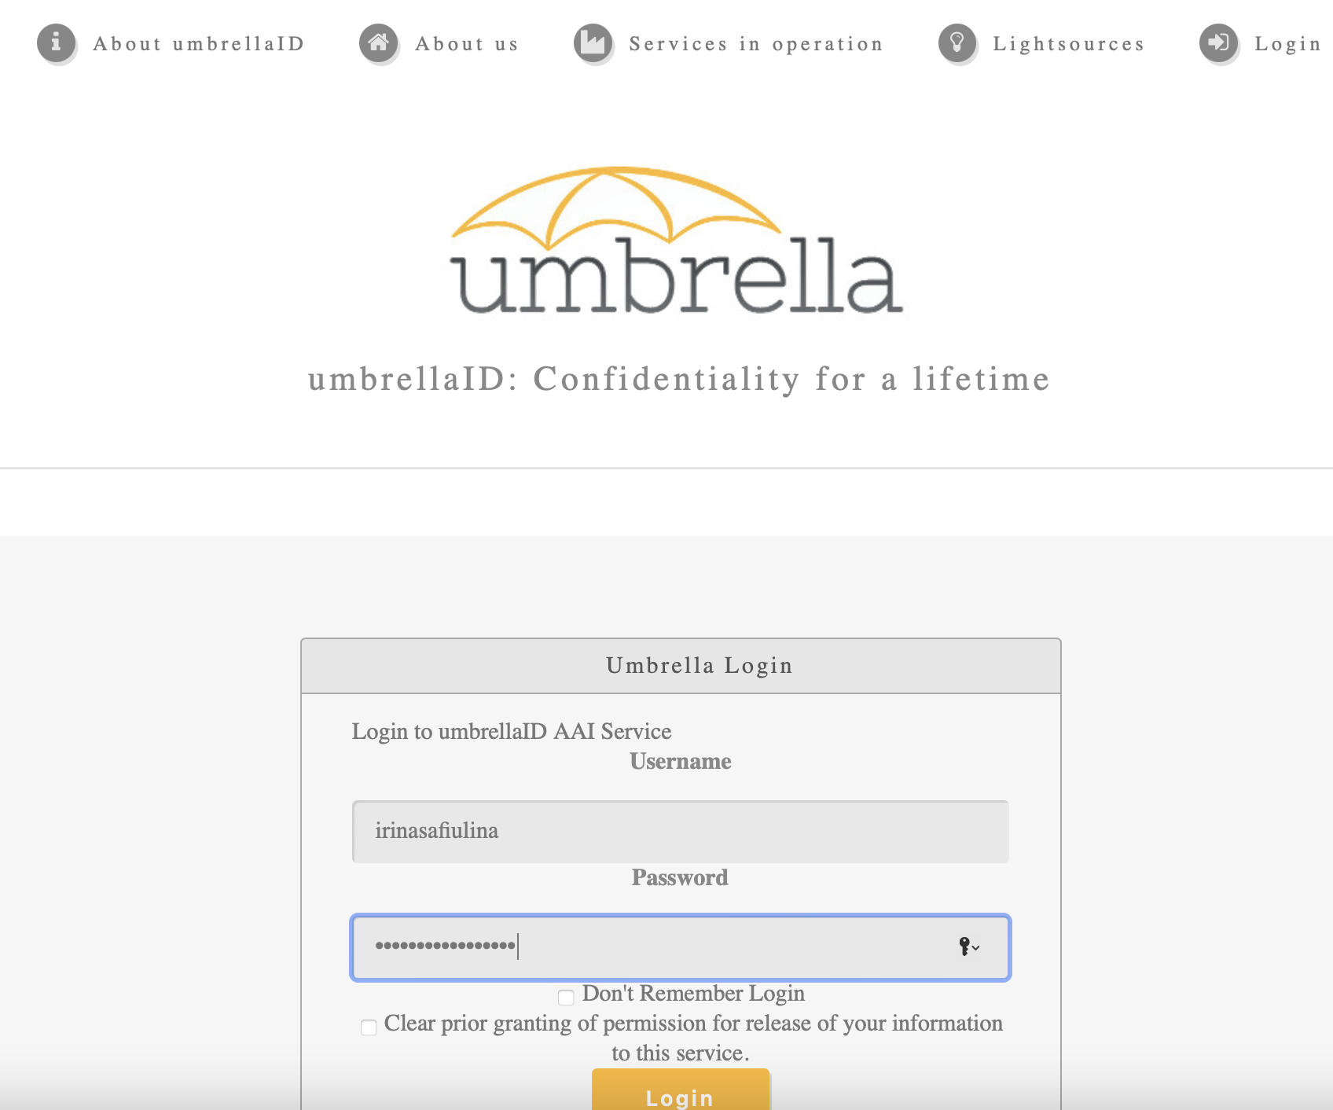
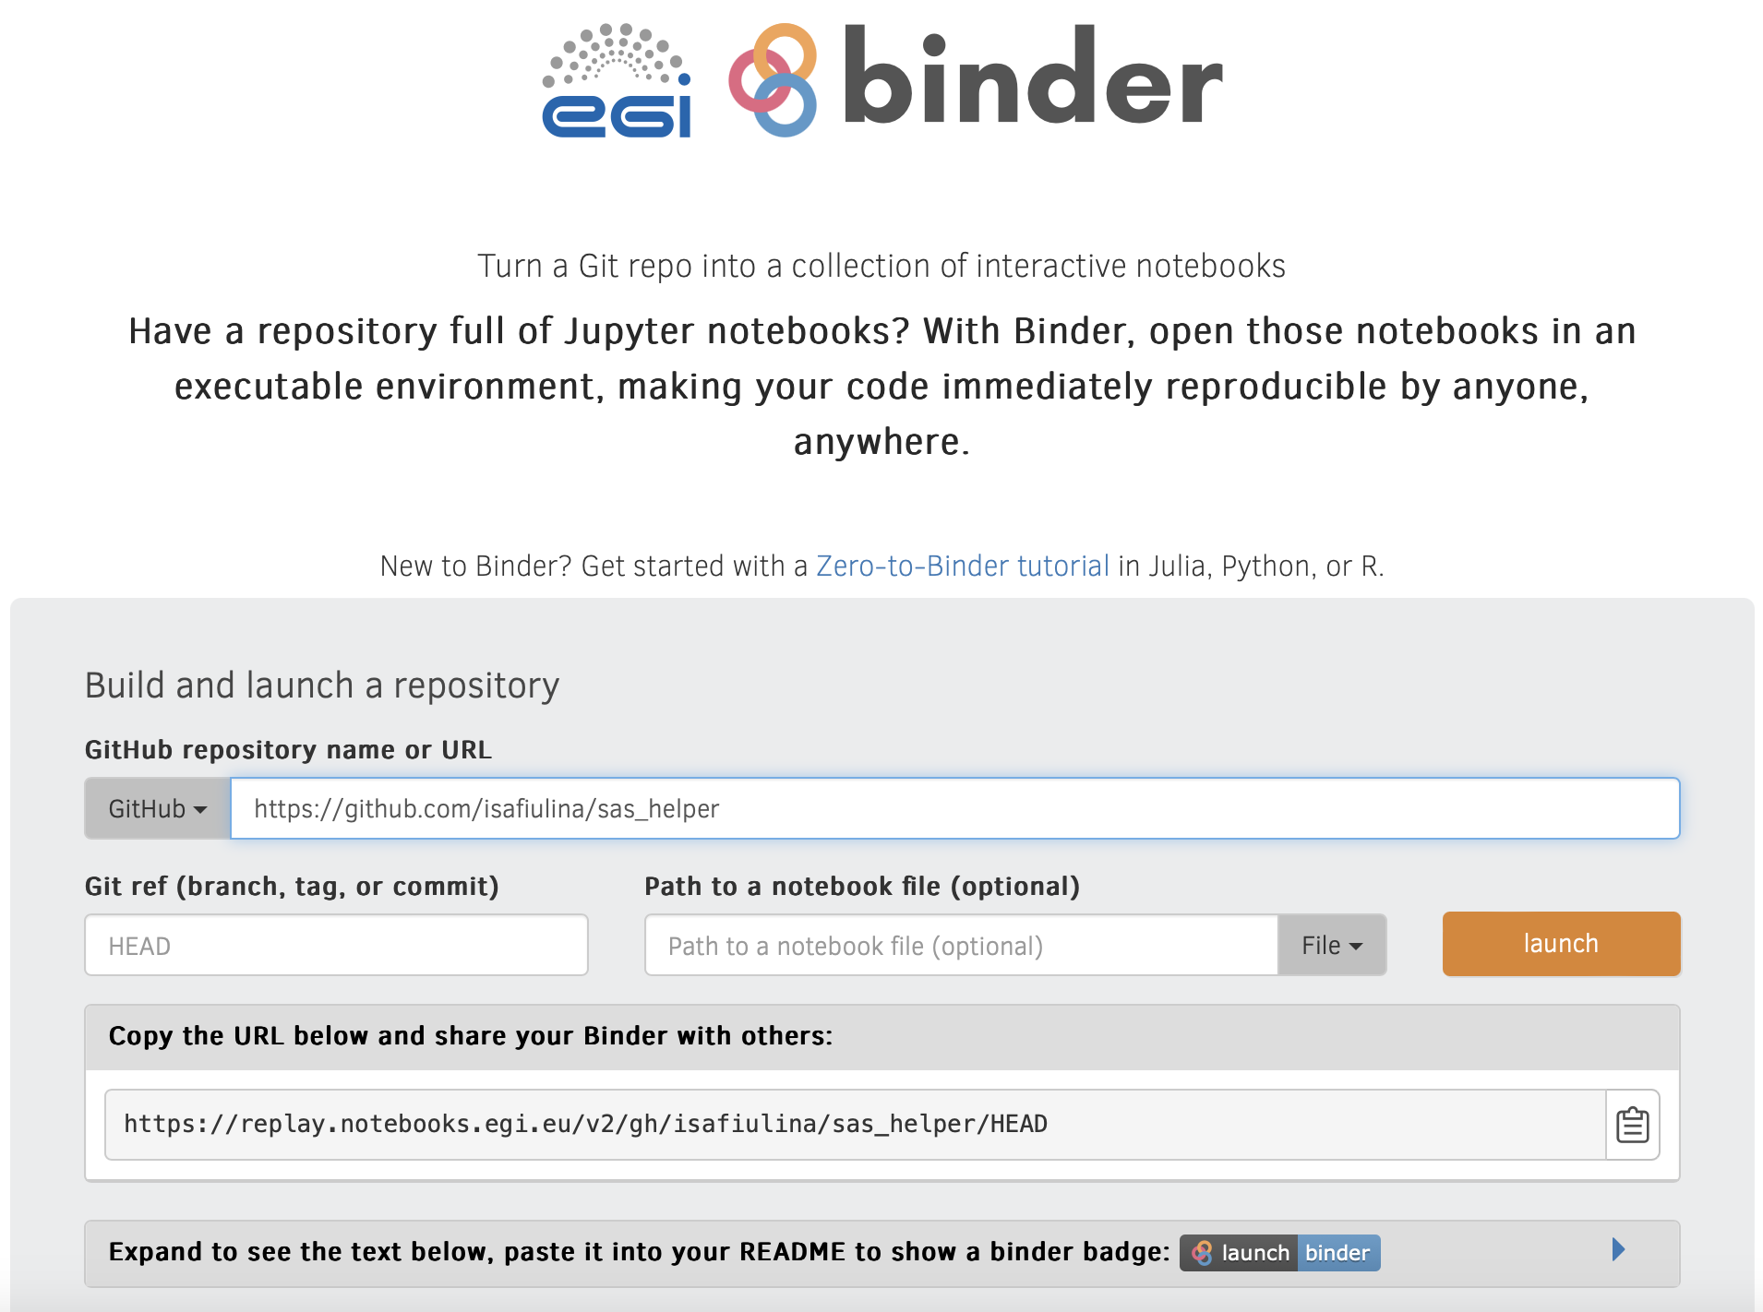
EOSC Future: SP8 walkthrough
STEP 1:
http://replay.notebooks.egi.eu
login using UmbrellaID
STEP 2:
https://github.com/isafiulina/sas_helper
binder
TO DO: Findable in EOSC Marketplace!

Slide 9
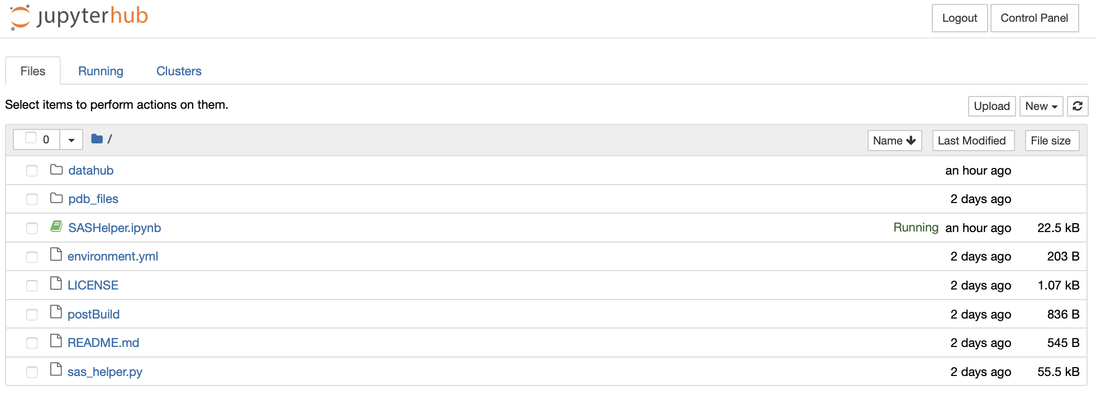
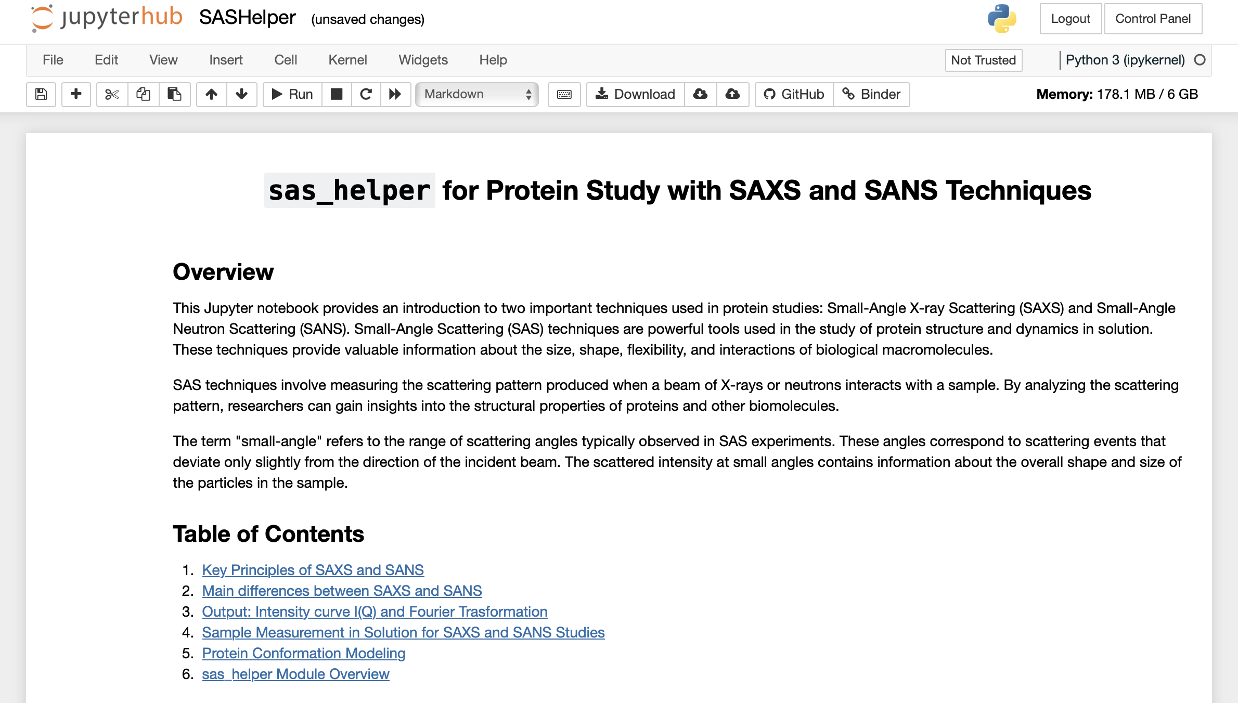
EOSC Future: SP8 walkthrough
STEP 3:
Jupyter Notebook environment
(upload data or go to Notebook)
STEP 4:
Scientific background provided
STEP 5:
Module explanations

Slide 10
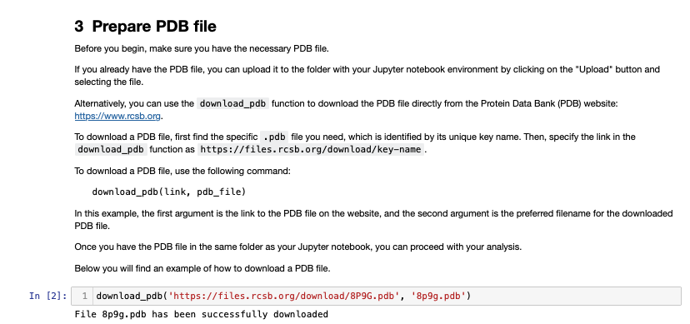
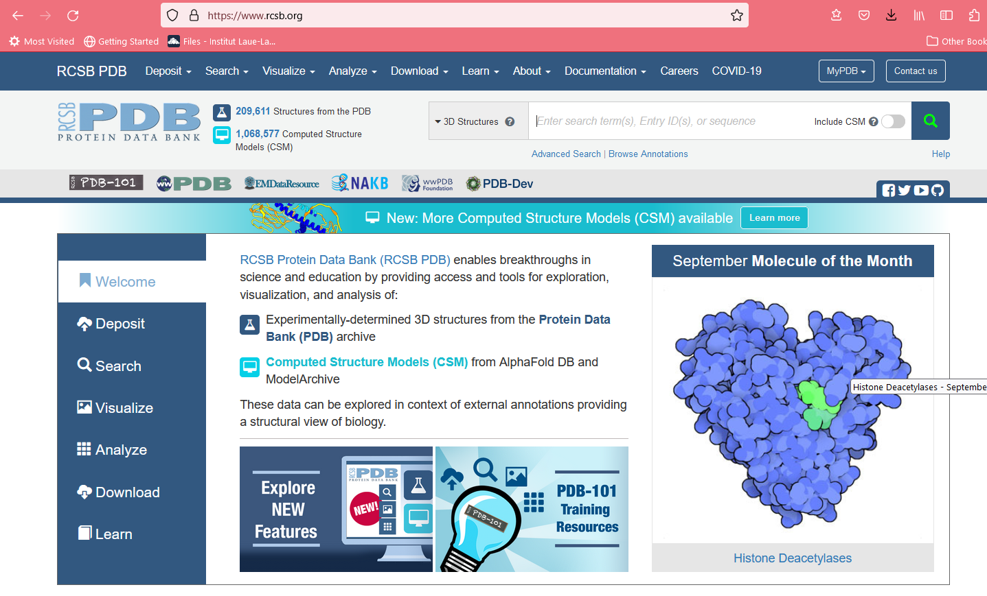
EOSC Future: SP8 walkthrough
STEP 6:
Get data from Open Data Base

Slide 11
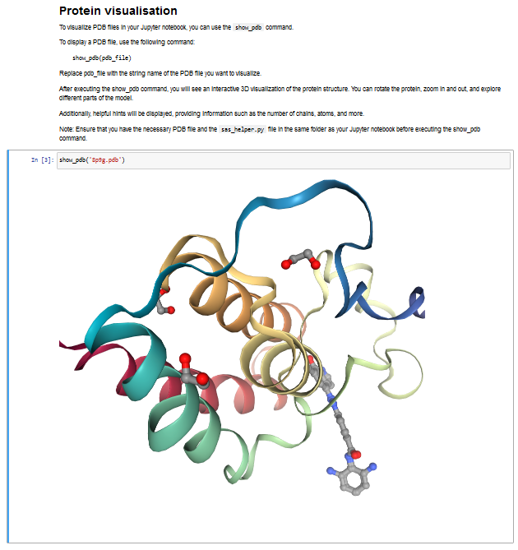
EOSC Future: SP8 walkthrough

Slide 12
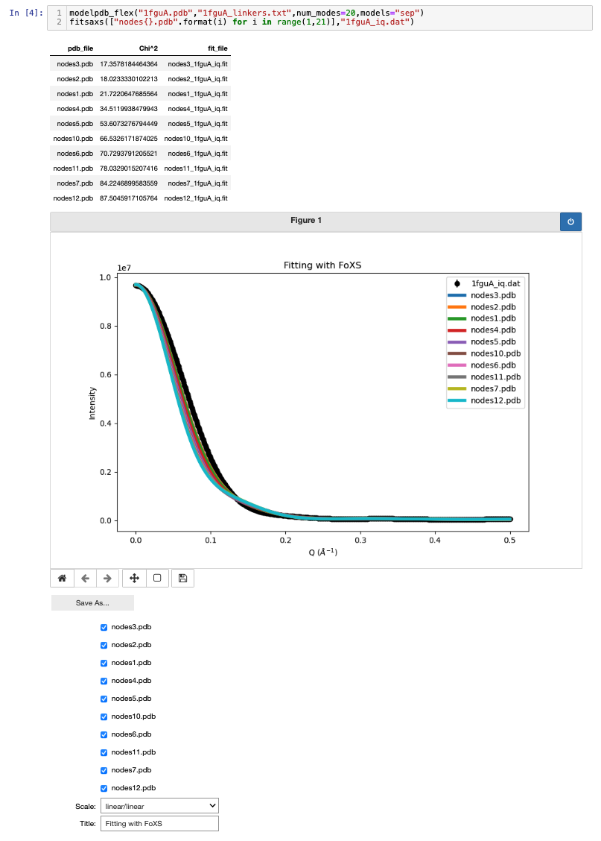
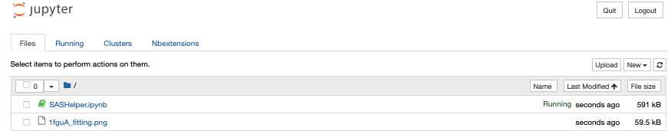
EOSC Future: SP8 walkthrough
STEP 7:
Do modelling and analysis with simple commands
Get comprehensive output
Interactive plotting
Save the result

Slide 13
EOSC Future: To do
Conclusions
Challenges
Work to do

Slide 14
Acknowledgments

